Slide 1
Chapter 2
PURCHASING MANAGEMENT

Slide 2
LEARNING OBJECTIVES
You should be able to:
Understand the role of supply management and its strategic impact on an organization’s competitive advantage
Have a basic knowledge of the manual purchasing process, e-procurement, public procurement, and green purchasing
Understand and know how to handle small value purchase orders
Understand sourcing decisions and the factors impacting supplier selection

Slide 3
LEARNING OBJECTIVES (Continued)
You should be able to:
Understand the pros and cons of single sourcing versus multiple sourcing
Understand the pros and cons of single versus multiple sourcing
Describe opportunities and challenges of global sourcing and its impacts on supply management
Understand and compute total cost of ownership

Slide 4
CHAPTER OUTLINE
Introduction
A Brief History of Purchasing Terms
The Role of Supply Management in an Organization
The Purchasing Process
Sourcing Decisions – The Make or Buy Decision
Roles of Supply Base
Supplier Selection
How Many Suppliers to Use
Purchasing Organization
International Purchasing/Global Sourcing
Procurement for Government/Non-Profits Agencies

Slide 5
A Brief History of Purchasing Terms
Purchasing – Obtaining merchandise, capital equipment; raw materials, services, or maintenance, repair, and operating (MRO) supplies in exchange for money or its equivalent
Merchants – Wholesalers and retailers who purchase for resale
Industrial Buyers – Purchase raw materials for conversion, services, capital equipment, & MRO supplies

Slide 6
A Brief History of Purchasing Terms (Continued)
Purchasing - key business function for acquiring materials, services, & equipment
Contracting - term often used for the acquisition of services
Supply Management - a newer term that encompasses all acquisition activities
  Institute of Supply management defined supply management as the “Identification, acquisition, access, positioning, and management of resources an organization needs or potentially needs in the attainment of its strategic objectives.”

Slide 7
The Role of Supply Management in an Organization
The primary goals of purchasing are:
  Ensure uninterrupted flows of raw materials at the lowest total cost,
  Improve quality of the finished goods produced, and
  Optimize customer satisfaction.
Purchasing contributes to these objectives by:
  Actively seeking better materials and reliable suppliers,
  Work closely with and exploiting the expertise of strategic suppliers to improve quality and materials
  Involving suppliers and purchasing personnel in new product design and development efforts.

Slide 8
The Role of Supply Management in an Organization (Continued)
The Financial Significance of Supply Management
  Profit-Leverage Effect
  A decrease in purchasing expenditures directly increases profits before taxes (assuming no decrease in quality or purchasing total cost)
  Return on Assets (ROA) Effect
  A high ROA indicates managerial prowess in generating profits with lower spending (caveat- ROA ratios vary from one industry to another)
  Inventory Turnover Effect
  Increased inventory turnovers indicate optimal utilization of space and inventory levels, increased sales, avoidance of inventory obsolesce

Slide 9
The Purchasing Process – Manual Purchasing (older system)
Step 1- Material Requisition/Purchase Requisition –
Stating product, quantity, and delivery date. May originate as a planned order release from the MRP system. Traveling requisition used for recurring orders.
Step 2- The Request for Quotation (RFQ) –
Buyer identifies suppliers & issues a request for quotation (RFQ) for routine items or a Request for Proposal (RFP) for more demanding products. Supplier Development is used to develop supplier capabilities.
Step 3- The Purchase Order (PO) –
Is the buyer’s offer & becomes a binding contract when accepted by supplier. When initiated by the supplier on their own terms, the document is a sales order. The Uniform Commercial Code (UCC) governs transactions in the U.S., except Louisiana.

Slide 10
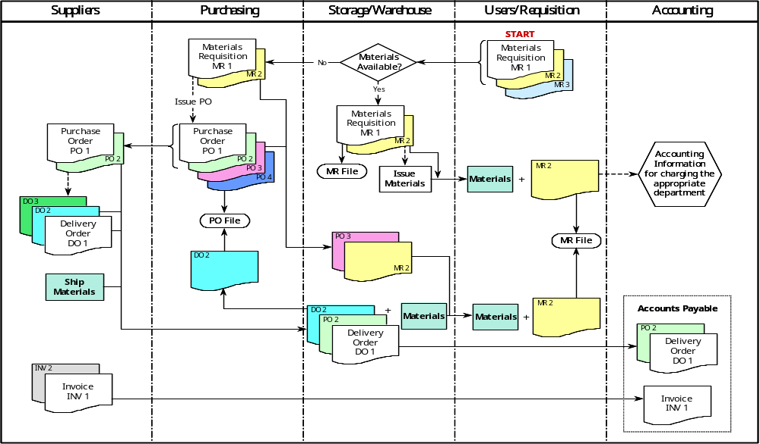
The Purchasing Process – Manual Purchasing
Figure 2.1

Slide 11
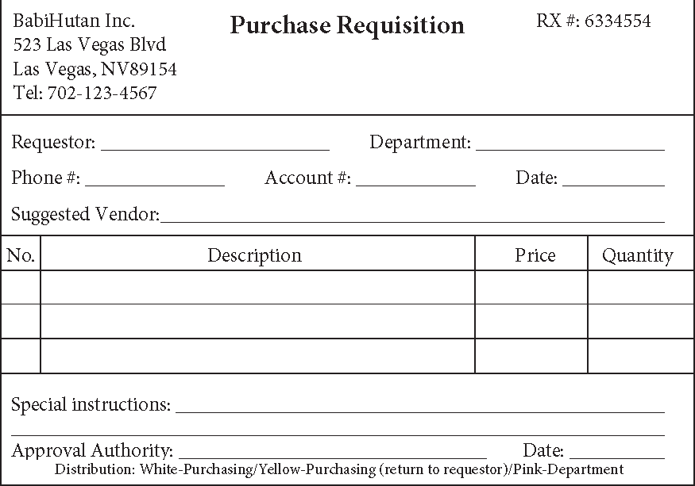
The Purchasing Process – Manual Purchasing (Continued)
Figure 2.2

Slide 12
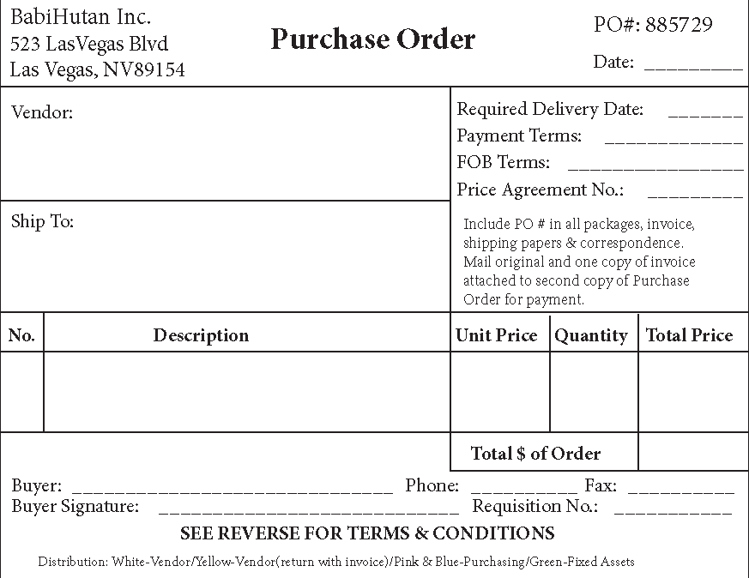
The Purchasing Process – Manual Purchasing (Continued)
Figure 2.3

Slide 13
The Purchasing Process – e-Procurement
Step 1- Material user inputs a materials requisition –
Relevant information such as quantity and date needed.
Step 2- Materials requisition submitted to buyer –
At purchasing department (hardcopy or electronically).
Step 3- Buyer assigns qualified suppliers to bid –
Product description, closing date, & conditions are given.
Step 4- Buyer reviews closed bids & selects a supplier

Slide 14
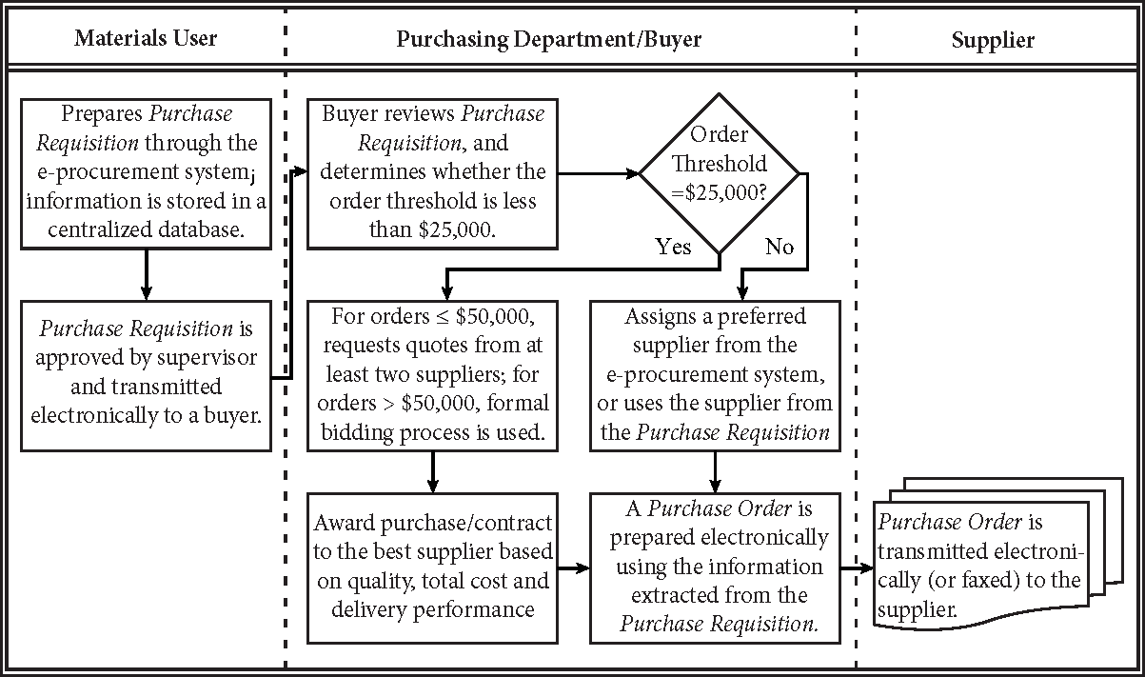
The Purchasing Process – e-Procurement
Figure 2.4

Slide 15
The Purchasing Process – e-Procurement (Continued)
Advantages of the e-Procurement System
  Time savings
  Cost savings
  Accuracy
  Real time
  Mobility
  Trackability
  Management
  Benefits to the suppliers

Slide 16
Small Value Purchase Orders
Processing costs for small value purchases are minimized through:
  Procurement Credit Card/Corporate Purchasing Card (P-card)
  Blanket or Open-End Purchase Orders
  Blank Check Purchase Orders
  Stockless Buying or System Contracting
  Petty Cash
  Standardization & Simplification of Materials & Components
  Accumulating Small Orders to Create a Large Order
  Using a Fixed Order Interval

Slide 17
Sourcing Decisions – The Make or Buy Decision
Outsourcing –
Buying materials and components from suppliers instead of making them in-house. The trend has moved toward outsourcing.
Backward vertical integration –
Refers to acquiring sources of supply
Forward vertical integration –
Refers to acquiring customer’s operations.
The Make or Buy decision is a strategic decision

Slide 18
Sourcing Decisions – The Make or Buy Decision (Continued)
Reasons for Buying or Outsourcing
  Cost advantage –
    Especially for components that are non-vital to the organization’s operations, suppliers may have economies of scale
  Insufficient capacity –
    A firm may be at or near capacity and subcontracting from a supplier may make better sense
  Lack of expertise –
    Firm may not have the necessary technology and expertise
  Quality –
    Suppliers have better technology, process, skilled labor, and the advantage of economy of scale

Slide 19
Sourcing Decisions – The Make or Buy Decision (Continued)
Reasons for Making
  Protect proprietary technology
  No competent supplier
  Better quality control
  Use existing idle capacity
  Control of lead-time transportation, and warehousing cost
  Lower cost

Slide 20
Roles of Supply Base
Supply Base - list of suppliers that a firm uses to acquire its materials, services, supplies, and equipment
  Firms emphasize long-term strategic supplier alliances consolidating volume into one or fewer suppliers, resulting in a smaller supply base
Preferred suppliers provide:
  Product and process technology and espertise to support buyer’s operations, particularly new product development and value analysis
  Information on latest trends in materials, processes, or designs
  Information on the supply market
  Capacity for meeting unexpected demand
  Cost efficiency due to economies of scale

Slide 21
Supplier Selection
The process of selecting suppliers, is complex and should be based on multiple criteria:
  Product and process technologies
  Willingness to share technologies & information
    Early supplier involvement (ESI)
    Concurrent engineering (CE)
  Quality
  Service
  Cost
    Total cost of ownership or acquisition
  Reliability
  Order system & cycle time
  Capacity
  Communication capability
  Location

Slide 22
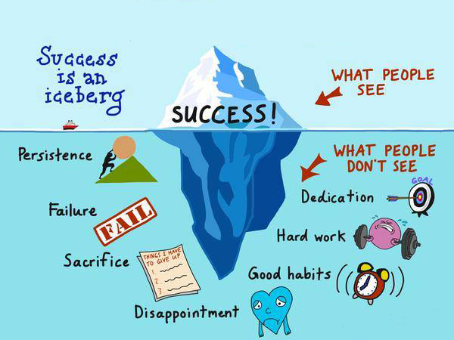
Analogy-TCO

Slide 23
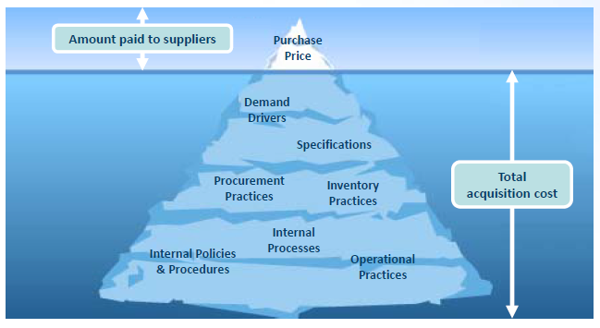
Analogy-TCO

Slide 24
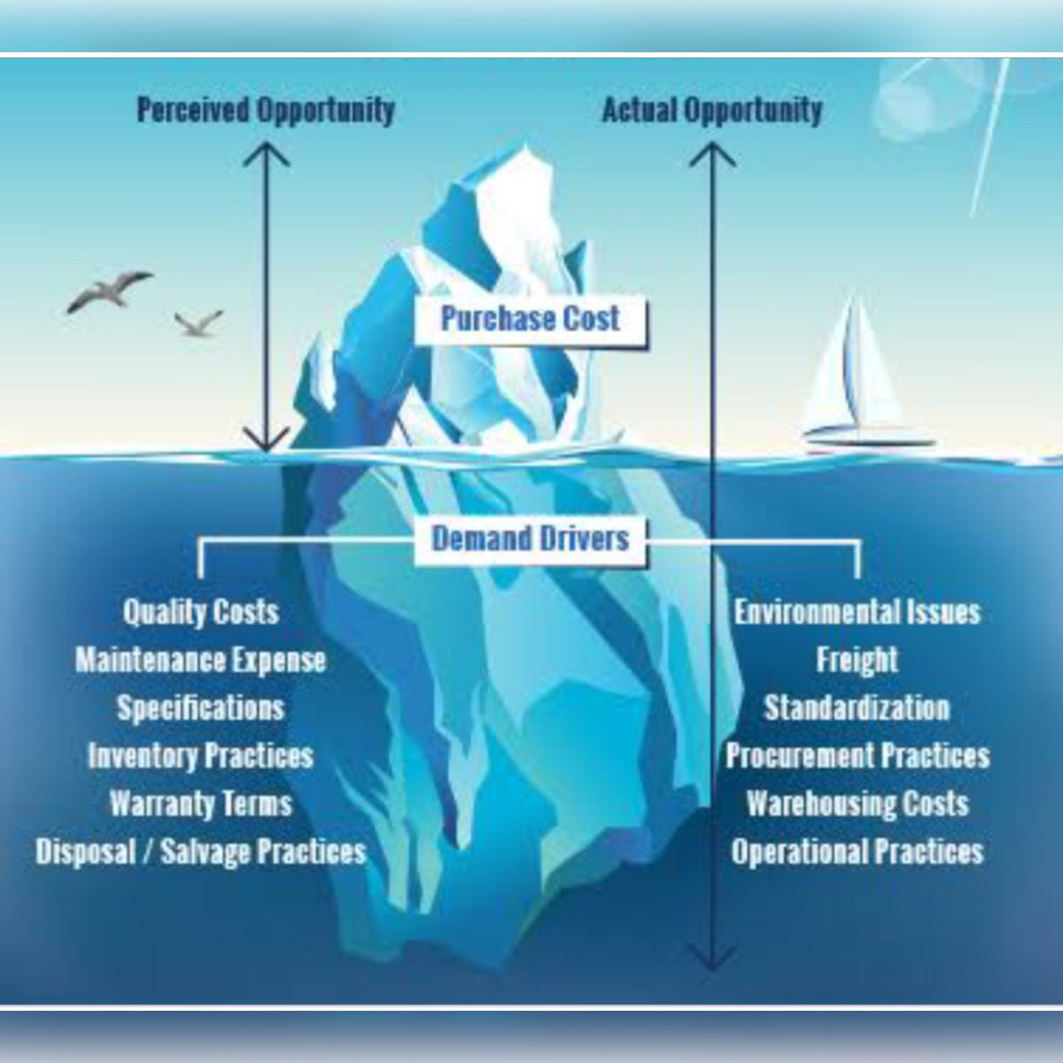
Analogy-TCO

Slide 25
Total Cost of Ownership
Total cost of ownership is a philosophy for really understanding all supply chain related costs of doing business with a particular supplier for a particular good or service (Lisa Ellam, May 1999)

Slide 26
TCO Components
Acquisition costs
  Purchase price
  Planning costs
  Quality costs
  Taxes
  Financing costs
Ownership costs
  Downtime costs
  Risk costs
  Cycle time costs
  Conversion costs
  Non-value added costs
  Supply chain costs
Post-ownership costs
  Environmental costs
  Warranty costs
  Product liability costs
  Customer dissatisfaction costs

Slide 27
Example-TCO
Kuantan ATV, Inc., assembles five different models of all-terrain vehicles (ATVs) from various ready-made components to serve the Las Vegas, Nevada, market. The company uses the same engine for all its ATVs.
The purchasing manager, Ms. Jane Kim, needs to choose a supplier for engines for the coming year. Due to the size of the warehouse and other administrative restrictions, she must order the engines in lot sizes of 1,000 each.
The unique characteristics of the standardized engine require special tooling to be used during the manufacturing process. Kuantan ATV agrees to reimburse the supplier for the tooling. This is a critical purchase, since late delivery of engines would disrupt production and cause 50 percent lost sales and 50 percent back orders of the ATVs.
Jane has obtained quotes from two reliable suppliers but needs to know which supplier is more cost-effective. She has the following information:

Slide 28
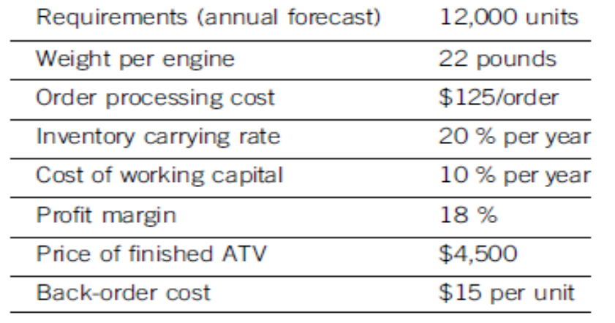
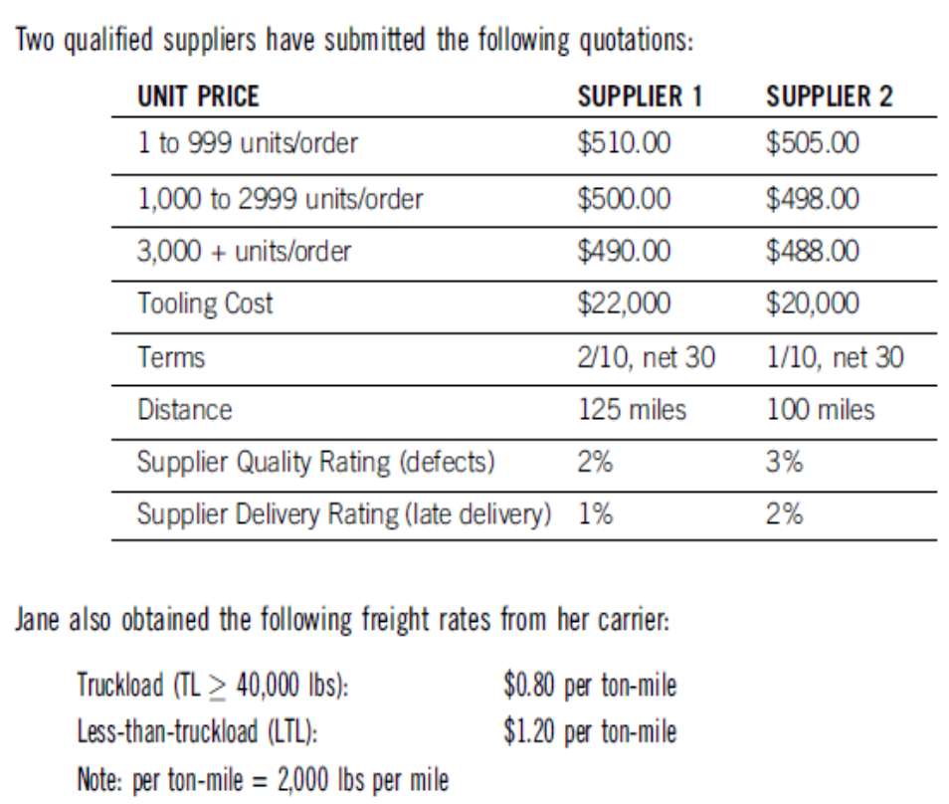

Slide 29
How Many Suppliers to Use
Single-source - a risky proposition. Current trends favor fewer sources.
Reasons Favoring a Single Supplier
To establish a good relationship
Less quality variability
Lower cost
Transportation economies
Proprietary product or process
Volume too small to split
Reasons Favoring Multiple Suppliers
Need capacity
Spread risk of supply interruption
Create competition
Information
Dealing with special kinds of business

Slide 30
Purchasing – Centralized vs. Decentralized
Purchasing Organization is dependent on many factors, such as market conditions & types of materials required
  Centralized Purchasing - purchasing department located at the firm’s corporate office makes all the purchasing decisions
  Decentralized Purchasing - individual, local purchasing departments, such as plant level, make their own purchasing decisions

Slide 31
Purchasing – Centralized vs. Decentralized (Continued)
Advantages -
Centralization
  Concentrated volume-
  Leveraging purchase volume
  Avoid duplication
  Specialization
  Lower transportation costs
  No competition within units
  Common supply base
Advantages - Decentralization
  Closer knowledge of requirements
  Local sourcing
  Less bureaucracy
A hybrid purchasing organization
  Decentralized-centralized (large multiunit org)- decentralized corporate and centralized at business unit
  Centralized-decentralized (large org w/centralized control) centralized large national contracts at corporate level and decentralized items specific to business unit

Slide 32
International Purchasing/Global Sourcing
Reasons for Global Sourcing –
Opportunity to improve quality, cost, and delivery performance
Potential Challenges –
Requires additional skills and knowledge to deal with international suppliers, logistics, communication, political environment, and other issues

Slide 33
Practice Questions
You are given the following information:
COSTS MAKE OPTION BUY OPTION
Fixed Cost (M)= $125,000 & Fixed Cost (B) = $5,000
Variable Cost (M) = $15 & Variable Cost (B) = $17
a. Find the break-even quantity and the total cost at the break-even point.
b. If the requirement is 150,000 units, is it more cost-effective for the firm to buy or
make the components? What is the cost savings for choosing the cheaper option?

Slide 34
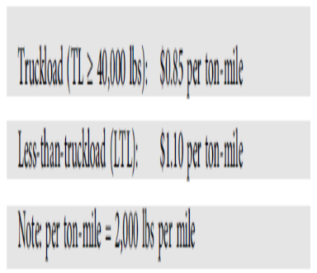
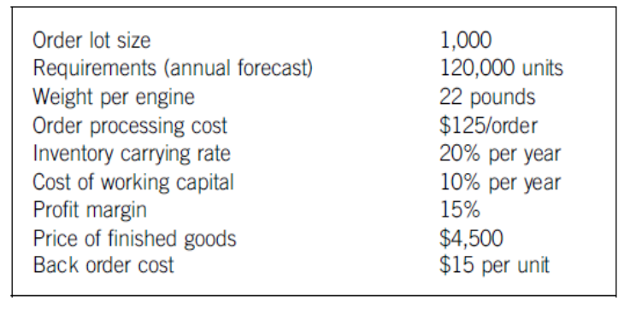
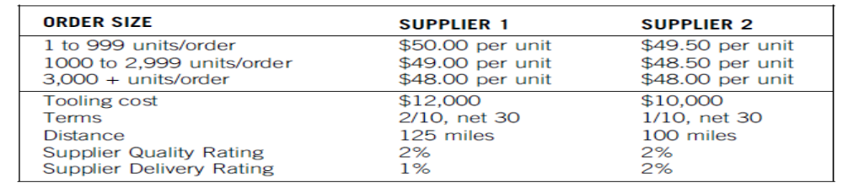
Practice Questions
Given the following information, use total cost analysis to determine which supplier
is more cost-effective. Late delivery of raw material results in 60 percent lost sales
and 40 percent back orders of finished goods.

